Slide 1


Evoastra Ventures Pvt Ltd Internship
Project
Name: Chaitanya Mangla
AI & ML Intern
Real World Datasets Energy Anomaly Detection Project

Slide 2


Objective of Anomaly Detection
The objective of anomaly detection in Machine Learning (ML) is to identify rare, unusual, or abnormal data points that differ significantly from the normal pattern in a dataset.
Main objectives of anomaly detection include:
1. Detect Unusual patterns
2. Identify errors
3. Detect Fraud and security threats

Slide 3

Anomaly Detection ML Algorithms
The main algorithms which are being used for the Anomaly Detection are :
1. Isolation Forest : This is used for calculating the global anomalies.
2. Local Outlier Factors : Its used for calculating the local anomalies.
3. Robust Covariance : Its used for calculating the statistical anomalies.
At end, we combine the results of the 3 anomalies for the detection purpose.

Slide 4

Anomaly Detection Projects
The various anomalies being made include:
1. Electricity
2. Water
3. Chilled Water
4. Hot Water
5. Solar Energy
6. Gas Consumption
7. Steam Data
8. Irrigation Data
9. Weather Data

Slide 5

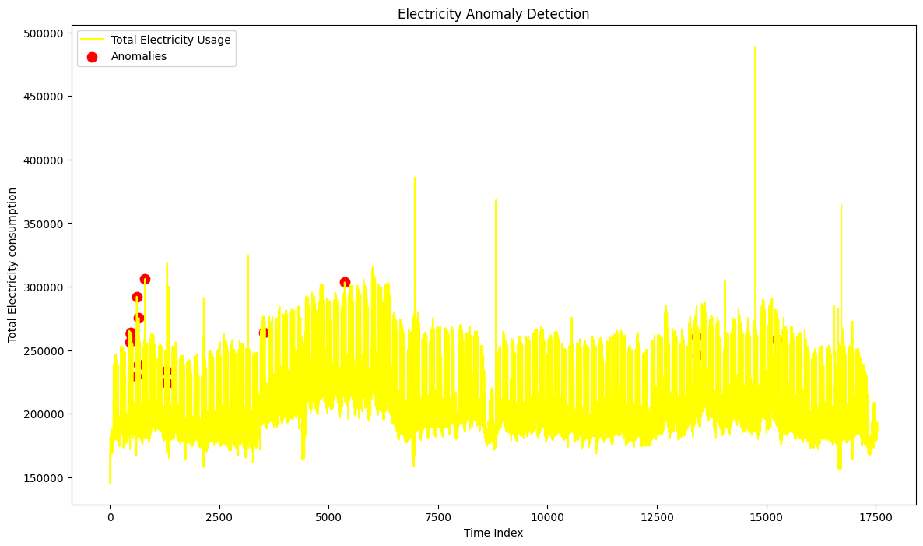
Electricity Anomaly Detection Graph

Slide 6

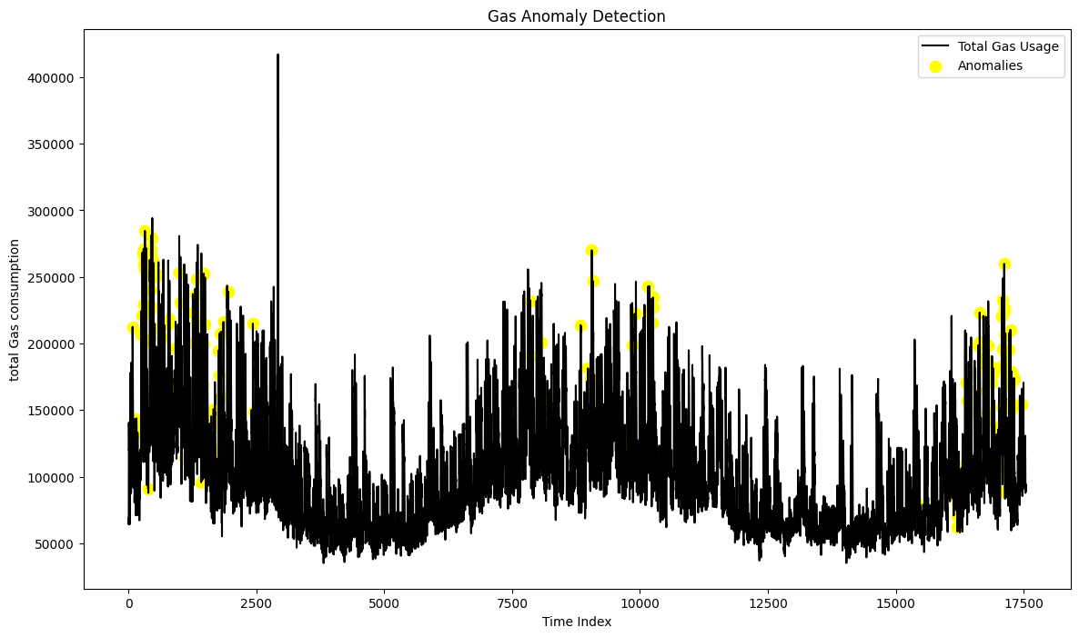
Gas Consumption Anomaly Detection

Slide 7
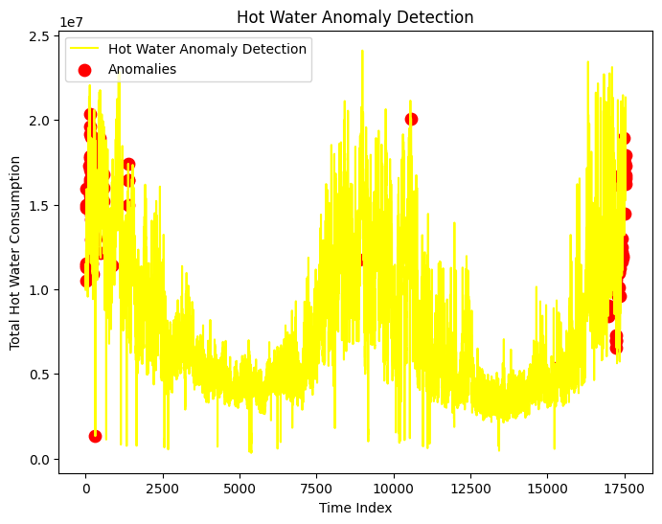
Hot Water Consumption Graph

Slide 8

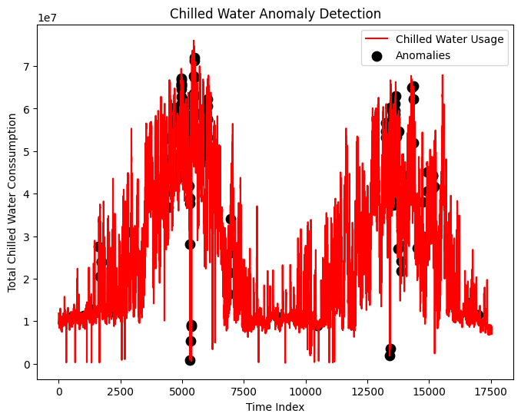
Chilled Water Consumption Data

Slide 9

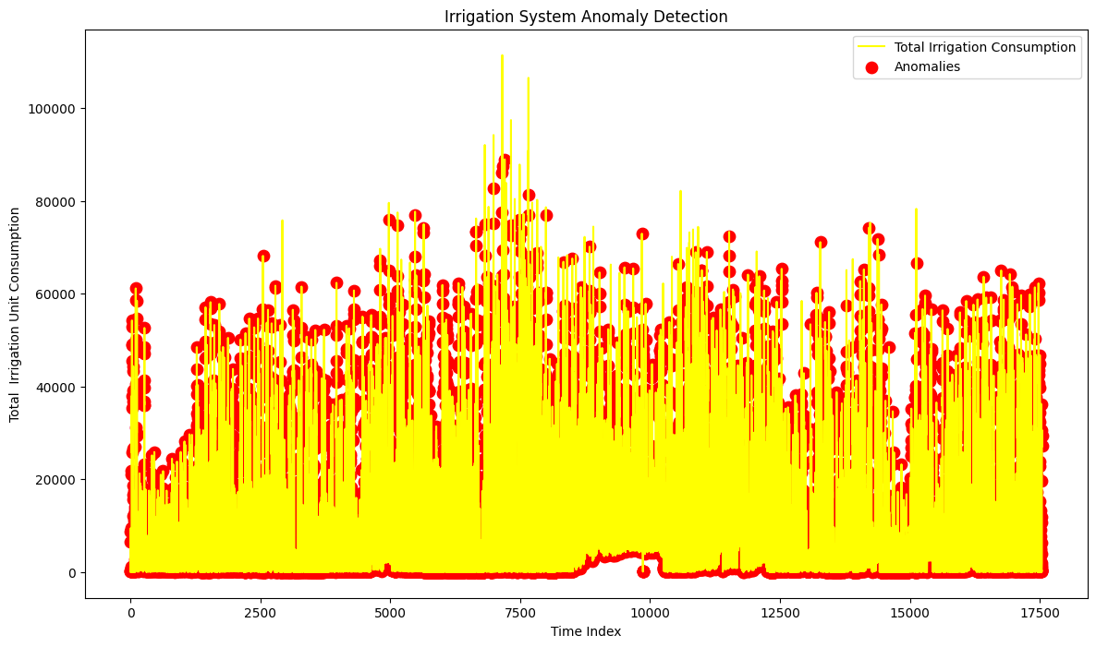
Irrigation Anomaly Detection Project

Slide 10
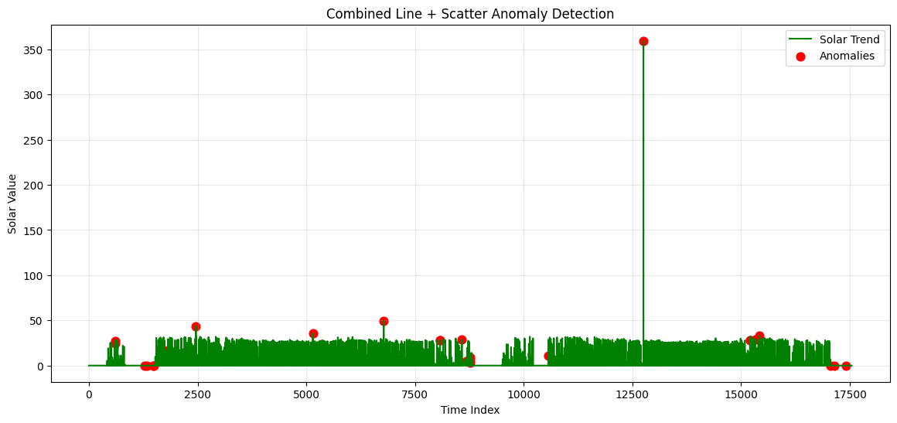
Solar Energy Anomaly Detection

Slide 11
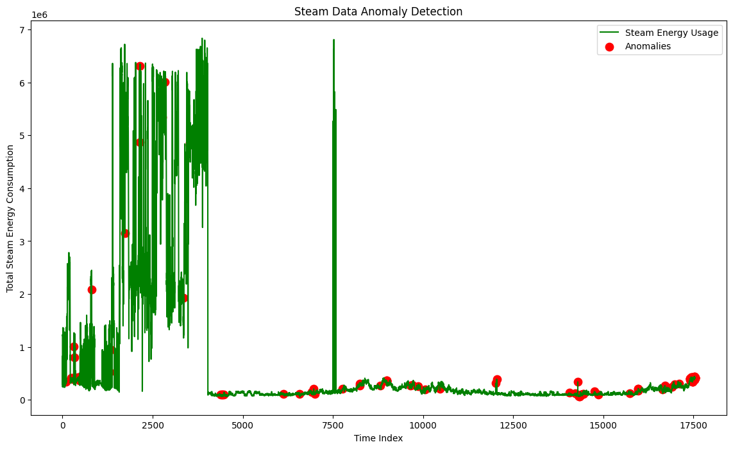
Steam Energy Anomaly Detection

Slide 12
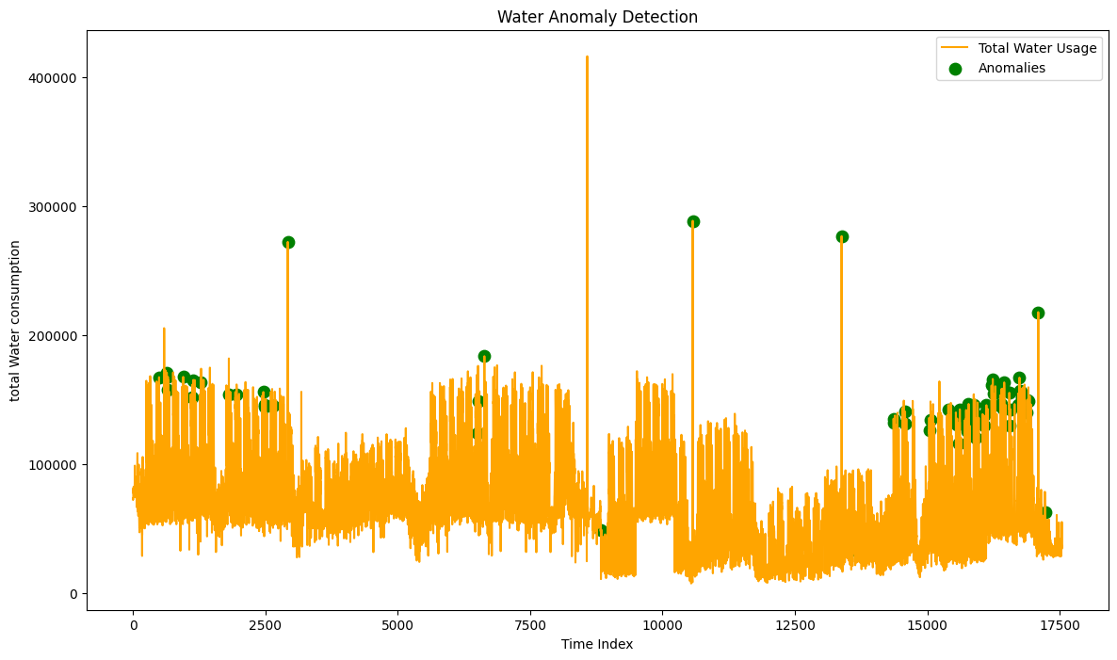
Water Anomaly Detection Project

Slide 13
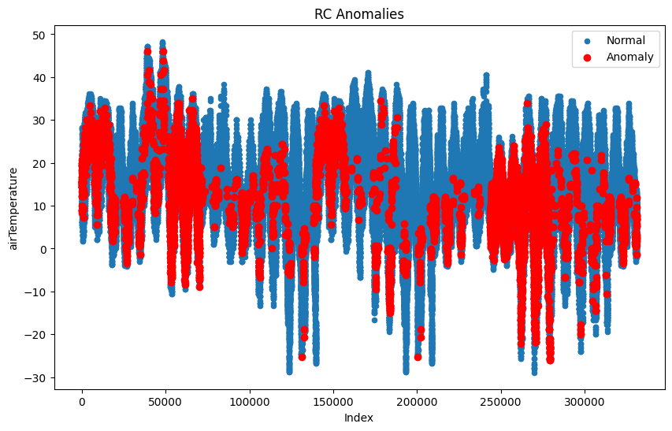
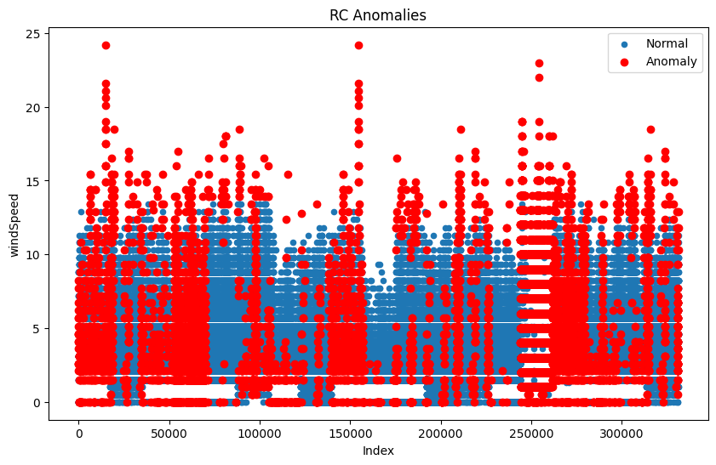
Weather Data Anomaly Detection

Slide 14
GitHub Link
Link for project : Click Here

